Slide 1
SSIS Performance Tuning

Slide 2


About me – Marcel Franke
Practice Lead Advanced Analytics & Data Science
pmOne AG – Germany Austria, Switzerland
P-TSP for Microsoft for Big Data & Data Analytics
Focus areas: Big Data & Data Analytics
Blog: www.nexxtjump.com
E-Mail: marcel.franke@pmOne.com

Slide 3


Organizer

Slide 4



Bronze Sponsor

Slide 5






Silver Sponsor

Slide 6




Gold Sponsor

Slide 7

You rock!

Slide 8

Save the date!

Slide 9

Agenda
Some Basics
Configuration & Settings
High Performance ETL with SSIS
Parallelismen strategies
Results & Summary

Slide 10

Understand the Basics OR exercises on the pool deck

Slide 11
Basics of Performance-Tuning
Typical observations
My <Insert workload here> runs too slow
Conclude that SQL Server is broken/doesn’t scale etc..
Forget about finding root cause and just change things randomly
Buy lots of bigger hardware and expect things to run faster
Please: „Don’t guess!“
Recommended approach
Know your systems & environments
Know your customer requirements: How fast does your data need to be loaded? (as fast as possible is no measure)
Test your baseline

Slide 12
The Tuning for Scale Loop
Compare to expected results
Discard or Accept Change
Generate Hypothesis
Change variable
Run and Measure
Agree on targets for optimization
Desired Runtime and Scale
CPU, Memory, I/O
Get a baseline
Make small change at a time and jump into the in the tuning loop
The greedy tuner doesn’t stop
“Tune it till it breaks, then fix it, so you can break it again”
...Know when to stop..

Slide 13
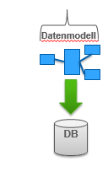
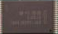



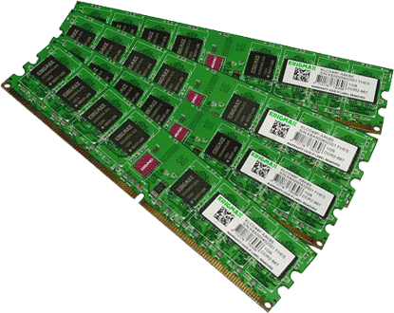

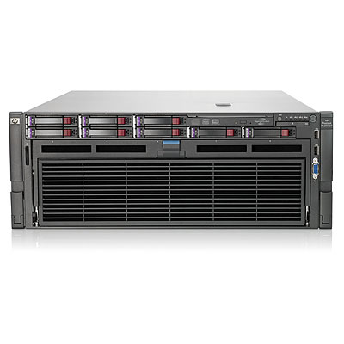

A typical Data Warehouse solution
Cache
Data
CPU
Disk
Memory

Slide 14

Measure your Baseline
Data Warehouse Reference Architecture: FastTrack
https://msdn.microsoft.com/de-de/library/hh918452.aspx
RTFM: Server specification -> What is built-in? What does the provider says?
CPUs / Cores: ~200 MB/s throughput per core
Memory: Task Manager
Storage: SQLIO

Slide 15
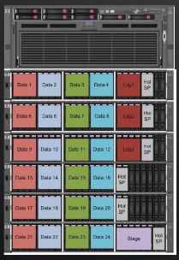
Hardware Configuration Server Components
Target Data Volume: 20 TB (compressed)
Server: DL580 G7
Processor: 4 x 8 Cores Intel Xeon X7560 (2.26 GHz)
Memory: 512GB
Host Bus Adapter: 5 HP 82E 8Gb Dual-port PCI-e FC HBA
Switch: 2 x HP 8/40 Base 24-ports Enabled SAN Switch
Storage: HP MSA 2000 G3
6 x MSA FC Dual Cntrl SFF Base Model
126 x HP 300GB 6G SAS 10K 2.5in DP ENT HDD
HP Smart Array P410i/1GB FBWC

Slide 16
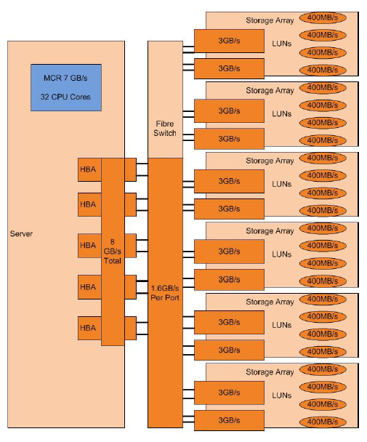
Hardware Configuration Storage Components
Disks Configuration
96 drives for user data (RAID 10)
12 drives for log data (RAID 10)
6 drives for staging data (RAID 5)
12 drives for hot space
LUN Layout
4 LUNs per Storage Enclosure
4 Disks per LUN

Slide 17

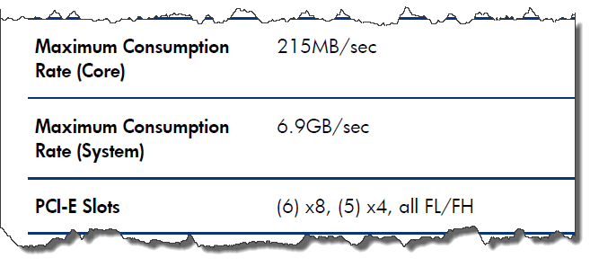
You have got a Server!!!
Do we really get what we expected?
SQLIO shows 4,7 GB/s

Slide 18
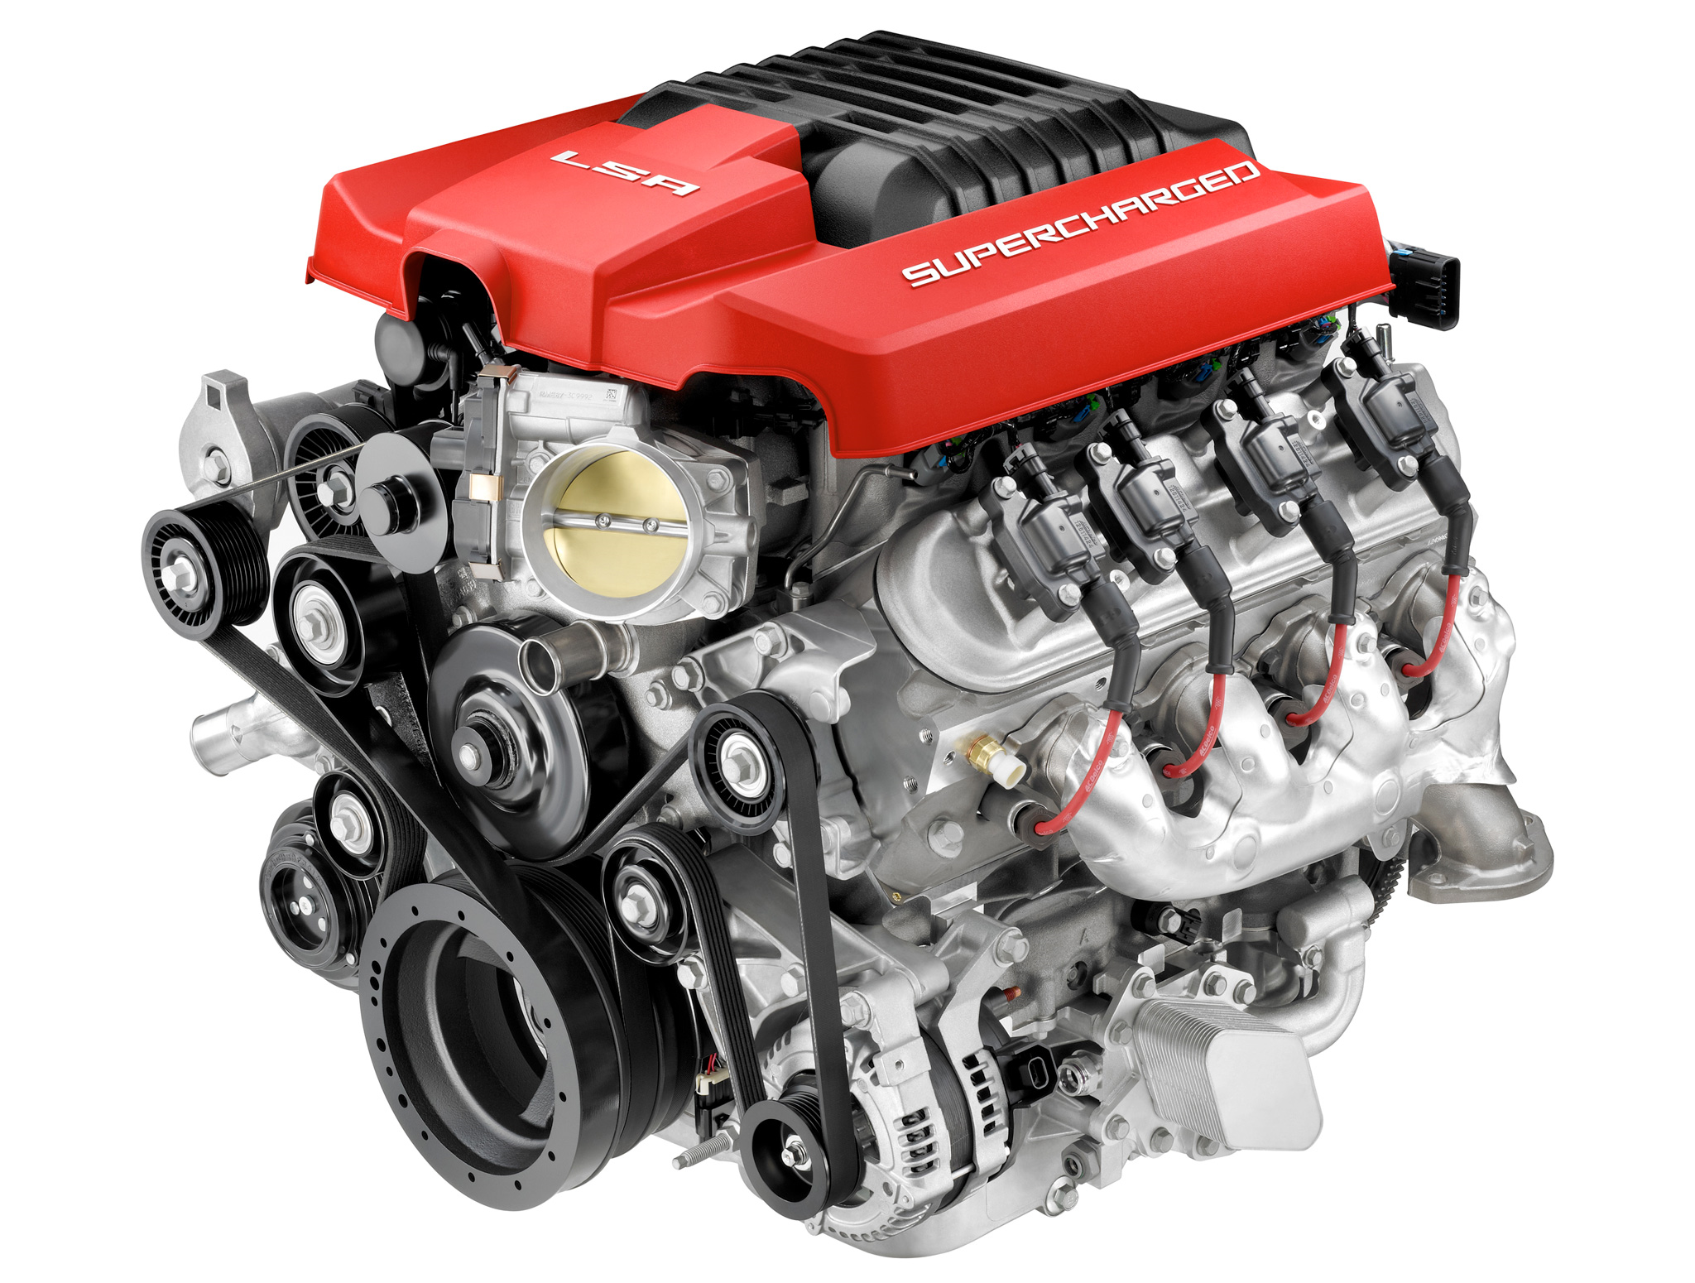
How does the SSIS Engine works?

Slide 19
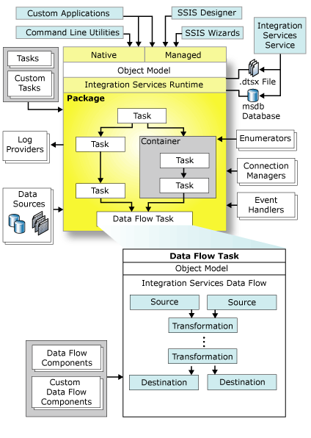
How does the SSIS Engine works? Architecture
SSIS Runtime Engine
Controls the Control Flow and Layout
Executes packages
Offers support for Logging, Debugging, Configuration, Connections, Transactions
SSIS Data Flow Engine
Built as Pipeline
Controls dataflows
Buffer-oriented architecture
Everything happens In-Memory
SSIS Inside View
SSIS Inside View Part 1
SSIS Inside View Part 2
SSIS Inside View Part 3
SSIS Inside View Part 4

Slide 20
How does the SSIS Engine works? Data Flow
Synchronous Transformations
Processes input row and send it to output at the same time
Input and Output use the same Buffer
Example: Character Map, Derived Column, Data Conversion, Row Count, Lookup, …
Asynchronous Transformations
Output defines a new Buffer (data needs to be copied)
Input and Output are not in sync
Divided into: partially blocking und blocking transformations

Slide 21

How does the SSIS Engine works? Data Flow
Partially blocking transformations
Data will be copied into a new buffer
Example: Merge, Merge Join, Union All, …
Blocking transformations
Data will be copied into a new buffer
All rows need to be read first
Example: Sort, Aggregate, …

Slide 22
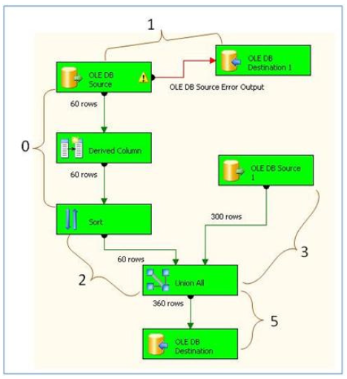
How does the SSIS Engine works? Data Flow
Execution Trees
Dataflow is grouped into Execution Trees
Group of transformations that begins with a data source or Asynchronous transformation and ends with an asynchronous transformations or a data sink
One buffer belongs to one execution tree
Are generated during runtime by Dataflow Engine
Every execution tree has it’s own threads

Slide 23
Best Practices for your package design
Build small packages for dedicated tasks, e.g. one package per Dimension or fact table
Use speaking names to name elements
Model your packages from top to down or from left to right
Don‘t create too complex dataflows. It‘s confusing and negative for your performance.
Use SQL Server for some Tasks (e.g. sort of input data, joins)
Stored Procedures or Plain SQL? Be careful with SP parameters!!!
Copy & Paste of elements is possible
Use auto-arrange functionality
Be consistent in your design

Slide 24

SETUP SQL Server Correctly

Slide 25
The Data Loading Performance Guide
The Data Loading Performance Guide
https://technet.microsoft.com/en-us/library/dd425070(v=sql.100).aspx
Authors: Thomas Kejser, Peter Carlin and Stuart Ozer
Checklist
Use SQL Server in Minimal Logging mode
Startup options: -E;-T1117;-T834;-T1118
Lock Pages in Memory : Enable user : (all users working with FT)
gpedit.msc -> Windows Settings -> Security Settings
SQL Server Maximum Memory Consumption
Max Worker Threads from 0 to 960 (for 32 cores)
LUNs formatted with 64KB allocation unit size

Slide 26

High Performance ETL
Let‘s make it fast

Slide 27
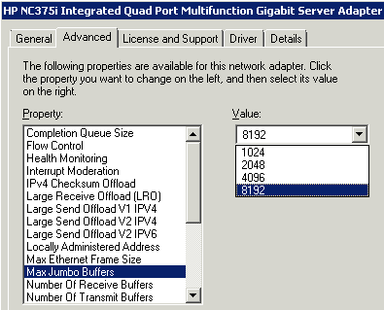
High Performance ETL Step 1: Hardware Tuning for High Performance ETL
Make sure your hardware gives its maximum
Network
Max Jumbo Buffers = 8192
Increases throughput by 15%

Slide 28
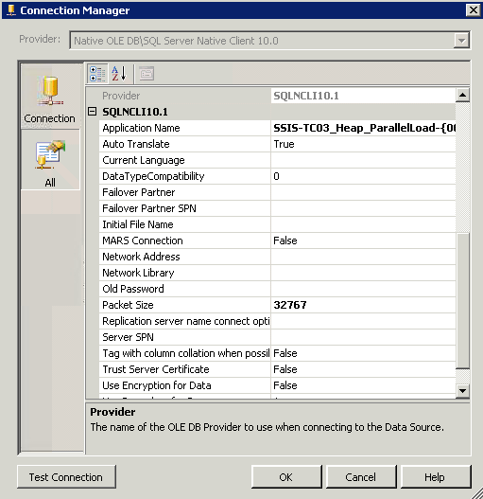
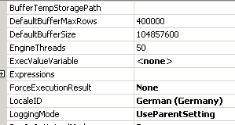
High Performance ETL Step 2: SSIS Settings for High Performance ETL
Connection Manager
Network Package Size = 32767 B
-> Increases throughput by 15%
Dataflow
DefaultBufferSize = 100 MB
EngineThreads = Execution Trees

Slide 29
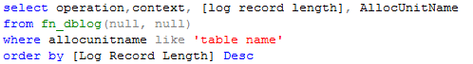
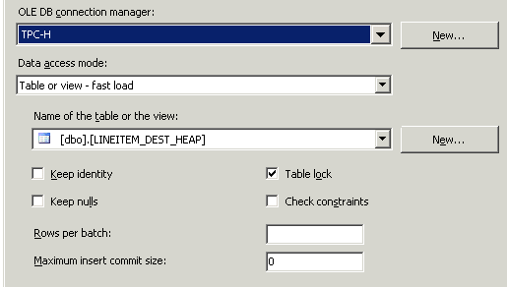
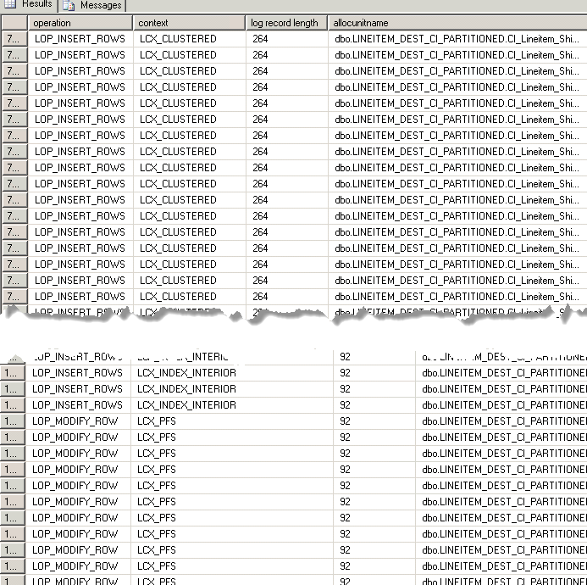
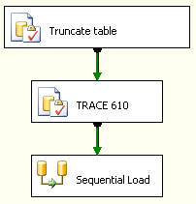
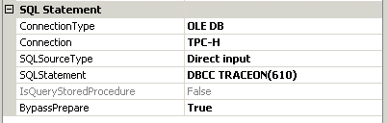
High Performance ETL Step 3: Be sure to be minimal logged
Heap Table
Fast Load
Table lock
Clustered Index Table
Fast Load
Trace Flag 610
Use one Connection Manager per Destination
Not minimally logged allocations
Minimally logged allocations

Slide 30
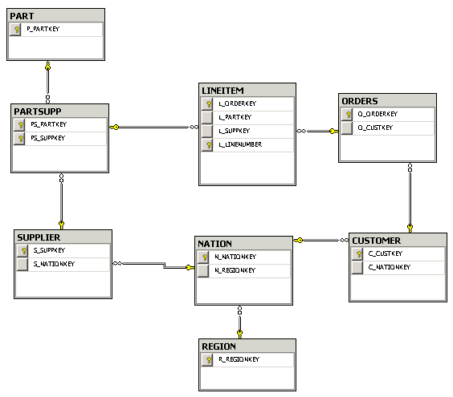
High Performance ETL Step 4: The data model
We used the TPC-H data model with test data
You can also download and reproduce
LINEITEM fact table as data source for SSIS tests
600M

Slide 31

How to load?
One stream or multiple streams?
MAX DOP high or low?
One table or one partition?
What is better HEAP or Clustered Index table?

Slide 32

Baseline tests

Slide 33
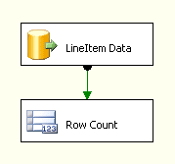
High Performance ETL Sequential Read
The easiest package ☺
Single threaded
Read Performance: 35 MB/s

Slide 34

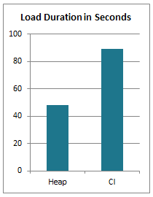
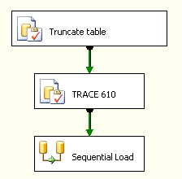
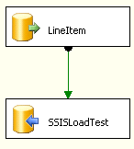
High Performance ETL Sequential Write
Still very easy ☺
Single threaded
Write Activity…
Heap: 23 MB/s (1111MB)
Cl: 40 MB/s (1128MB)
Notes:
Speaker: Alexei

Slide 35
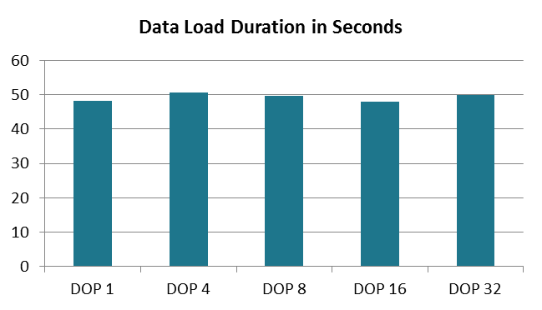
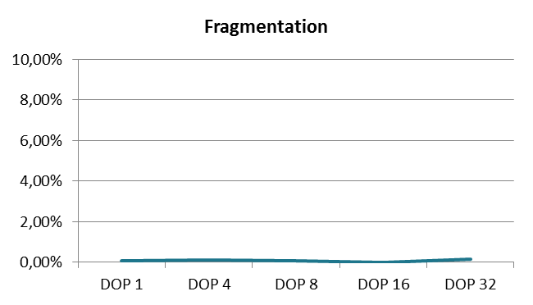
High Performance ETL Validating DOP impact
BULK API is single threaded
Notes:
Speaker: Alexei

Slide 36
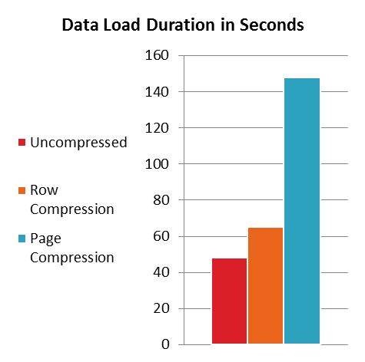
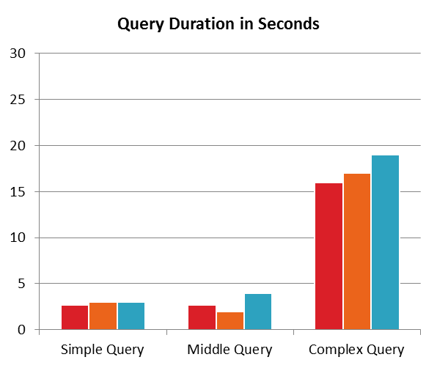
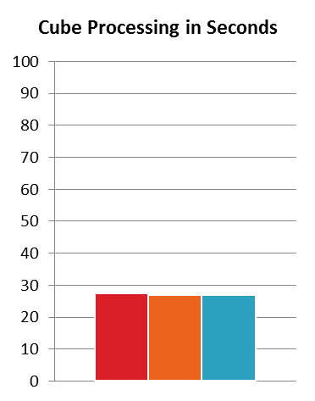
High Performance ETL Compression
+208%
+35%

Slide 37
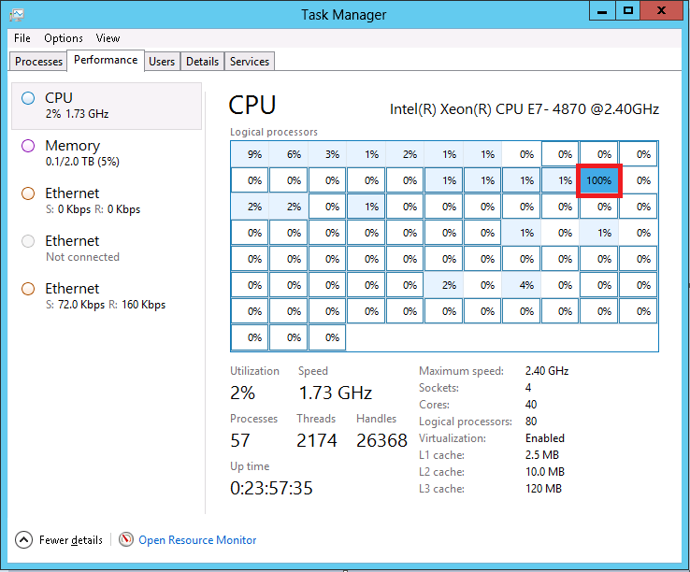
The baseline summary
Bound by single thread
Do not load into compressed table
Max write speed approx. ~20 MB/sec
We want it faster? Do it parallel !!!

Slide 38

Let’s do it parallel

Slide 39


Our Scale-Map
Non partitioned table
Functional partitioned table (e.g. month)
Hash partitioning

Slide 40
Our Scale-Map
Non partitioned table
Functional partitioned table (e.g. month)
Hash partitioning

Slide 41
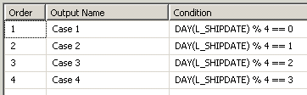
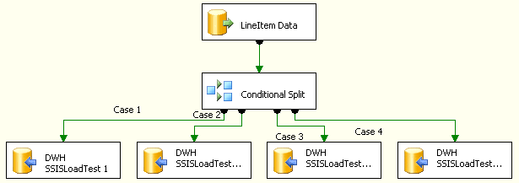
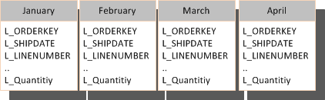
High Performance ETL Load one month into single partition
Load with multiple streams direct into Heap or CI
Target table partitioned by month
4, 8, 16 Streams in parallel
Notes:
Speaker: Marcel

Slide 42
High Performance ETL
Load one month into single partition
The SSIS Data Source is limited with ~200MB/s
Good balance of Sources & Destinations is 1:4
If you need more, create more Dataflows
Notes:
Speaker: Marcel

Slide 43
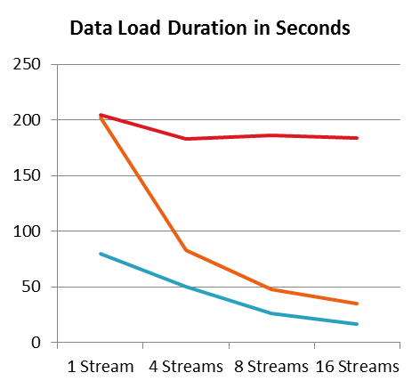
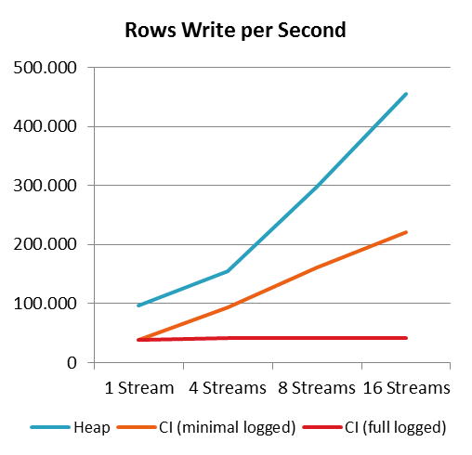
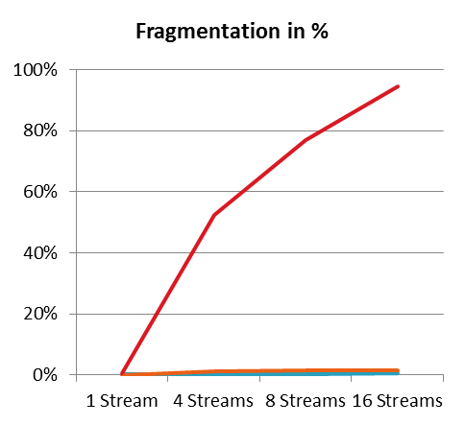
High Performance ETL
Load one month into single partition
Notes:
Speaker: Marcel

Slide 44

High Performance ETL
Load one month into single partition
Data is sorted by partition key, even if we load into heap partitioned table
Notes:
Speaker: Marcel

Slide 45
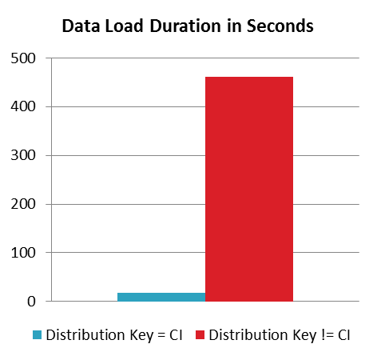
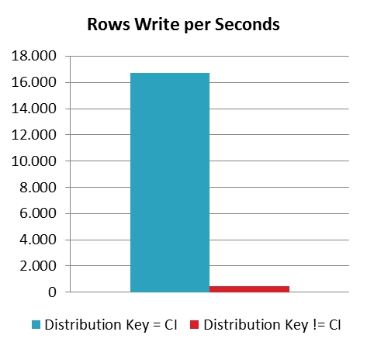
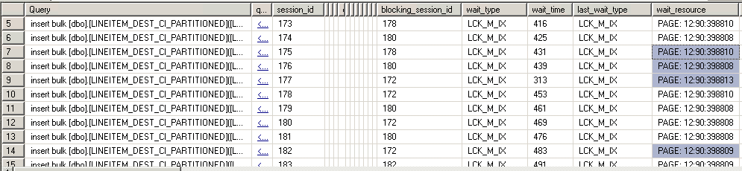
High Performance ETL Distribution Key
Choose the right Distribution Key for CI Tables
Best Practice: Distribution Key = Clustered Index
Notes:
Speaker: Marcel

Slide 46
Conclusion
Loading with multiple streams into the HEAP table is the fastest option
Loading into Clustered Index is acceptable if:
Minimally logged
Ranges not overlapping (hard to achieve)
Keep eye on fragmentation for DOP higher then 8

Slide 47
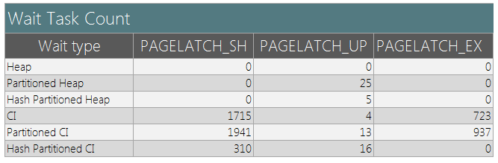
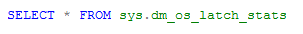
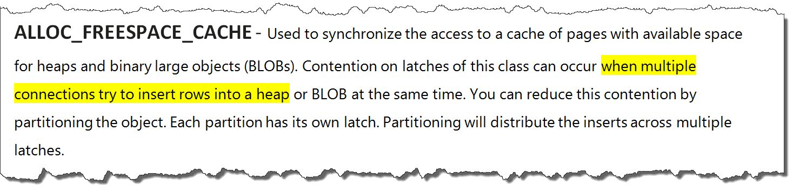
PAGELATCH_X
Overview of Wait Task Count per Table design during data loads with multiple streams
Notes:
Speaker: Alexei

Slide 48
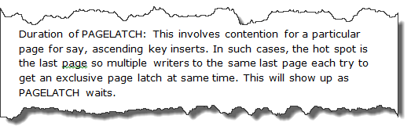
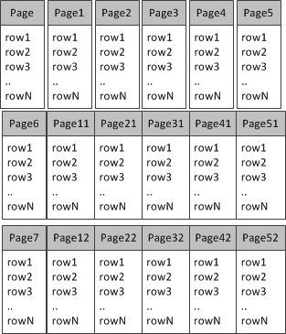
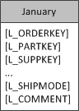
PAGELATCH_X
Notes:
Speaker: Alexei

Slide 49

Our Scale-Map
Non partitioned table
Functional partitioned table (e.g. month)
Hash partitioning

Slide 50
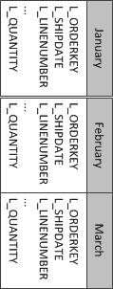
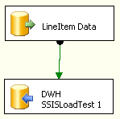
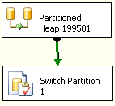
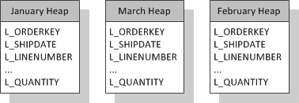
High Performance ETL
Strategy to avoid SORT
Load with 1 Stream into staging table
Switch staging table into target Heap or CI table
1, 8, 16 month in parallel
Data Source
Loading data

Slide 51
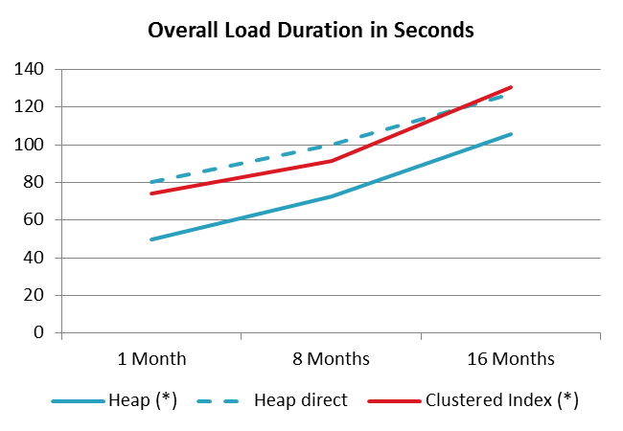
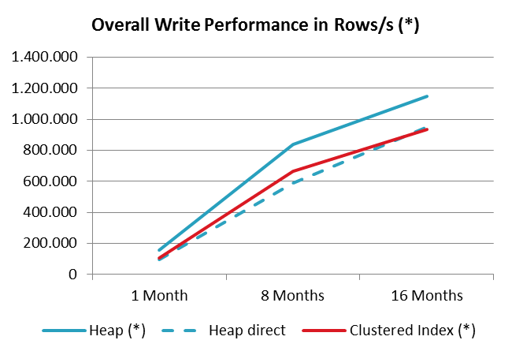
High Performance ETL
Strategy to avoid SORT
*Measured values for load from beginning till data available in partition table

Slide 52
But what if loading one month is not fast enough?
Need to load with more streams
Have to avoid PAGELATCH_X
This is possible with using hash partitioning

Slide 53
Our Scale-Map
Non partitioned table
Functional partitioned table (e.g. month)
Hash partitioning
Notes:
Das macht PDW auch

Slide 54



Hash Partition Basis
HASH partitioned table
Load Streams
Hash Function
Notes:
Speaker: Alexei

Slide 55

High Performance ETL
Hash Partitioning – Table Design
Notes:
Speaker: Marcel

Slide 56




High Performance ETL
Hash Partitioning – Scale of Hash Partitions
Load with multiple streams into hash partitioned heap table
1 Stream per partition
Target table partitioned by HashID
4, 8, 16 hash partitions in parallel
Data Source
Notes:
Speaker: Marcel

Slide 57


High Performance ETL
Hash Partitioning – Scale of Hash Partitions
Notes:
Speaker: Marcel

Slide 58



High Performance ETL
Hash Partitioning – Scale of Parallelism
Load with multiple streams in Hash partitioned Heap
4 Streams per table
1, 8, 16 month in parallel
Jan
Data Source
Notes:
Speaker: Marcel

Slide 59


High Performance ETL
Hash Partitioning – Scale of Parallelism
*with 4 Partitions per Table
Notes:
Speaker: Marcel

Slide 60
Conclusion
Think of…
…how many partitions you have to load?
…how many cores are available?
!Choose the right strategy of parallelism
We see SORT again:
? Idea to prove: Can we squeeze more work if we get rid of SORT?
Notes:
Speaker: Marcel

Slide 61
Our Scale-Map
Non partitioned table
Functional partitioned table (e.g. month)
Hash partitioning

Slide 62






High Performance ETL
Hash Partitioning with Partition Switch
Load with 1 stream per staging table
4 hash partitions per table
Switch staging table into partitioned Heap
1, 8, 16 month in parallel
Jan
Data Source
Loading data
Partition Switch
Notes:
Speaker: Marcel

Slide 63


High Performance ETL
Hash Partitioning with Partition Switch - Results
Notes:
Speaker: Marcel

Slide 64
Our Scale-Map
Non partitioned table
Functional partitioned table (e.g. month)
Hash partitioning

Slide 65
Results & Summary

Slide 66
Loading 1 month of data Loading Strategy vs. Number of Cores
Strategy | Rows Write/s | Number of Threads | Recommen-dation
Table or single Partition (Direct) | 450.000 | 16
Partition by month (Switch In) | 155.000 | 1
Hash Partitioning (Direct) (*) | 500.000 | 16
Hash Partitioning (Switch In) (*) | 775.000 | 16
*16 Hash Partitions

Slide 67
Loading 8 months of data Loading Strategy vs. Number of Cores
Strategy | Rows Write/s | Number of Threads | Recommen-dation
Table or single Partition (Direct) | 600.000 | 32
Partition by month (Switch In) | 840.000 | 8
Hash Partitioning (Direct) (*) | 870.000 | 32
Hash Partitioning (Switch In) (*) | 1.000.000 | 32
*4 Hash Partitions
Notes:
Speaker: Marcel

Slide 68
Loading 16 months of data Loading Strategy vs. Number of Cores
Strategy | Rows Write/s | Number of Threads | Recommen-dation
Table or single Partition (Direct) | 970.000 | 64
Partition by month (Switch In) | 1.150.000 | 16
Hash Partitioning (Direct) (*) | 590.000 | 64
Hash Partitioning (Switch In) (*) | 815.000 | 64
*4 Hash Partitions
Notes:
Speaker: Marcel

Slide 69



Can I partition by both Month and HASH?
Month indicator
January
Offset

Slide 70

Scale-Out

Slide 71

SSIS Scale-Out Whitepaper
Scale-Out SQL Server Integration Services Environment: A Sample Pattern
https://msdn.microsoft.com/en-us/dn887191.aspx

Slide 72

Questions?

Slide 73


